Slide 1
Entering Grade 11 Course Selection 2023-24
Grade 10
Parent Information Session

Slide 2
Changes to credit system
Formerly, credits ( 1 course = 1 credit hour)
Now, credit hours (one course = 4 credit hours)

Slide 3
Graduation Requirements
Must earn 18 out of 21 courses (72 out of 84 credit hours)
8 required courses (32 credit hours)
10 elective courses (40 credit hours)
5 Grade 12 courses incl. Eng 12 (20 credit hours)
Max 2 courses can be local options(8/72 credit hours)
or 3/19 courses (12/76 credit hours)
or 4/20 courses (16/80 credit hours)
You are responsible for ensuring that you meet graduation requirements!

Slide 4
Graduation Requirements
Required Courses:
English 11 Informational Text
English 11 Literary Text
2 Math courses from (NRF 10, Foundations 110, Fin & Workplace 110, Fin and Workplace 120 or NBCC Skilled Trades Math 120 – only in grade 12)
Science course
Humanities course
Fine Arts & Life Development course
English 12
Total: 8 courses = 32 credit hours
ELPA must be passed; re-writes in gr. 11

Slide 5
Course Levels
Level 1- Enriched university preparation; faster pace and increased scope
e.g. English 111, Chemistry 111, Physics 111
Level 2- University preparation, some community college & private training technology programs (not all require level 2-look up the programs of interest)
e.g. English 112, Modern History 112

Slide 6
Course Levels
Level 3- Non-technical community college & private training institutions
e.g. English 113, History 113
Level 0-Not offered at other levels
Will vary in difficulty. Some qualify for university entrance and some do not. Every university is different in what they accept as academic electives-look them up!
e.g. Law 120, Media Studies 120 and many others are accepted at most universities.

Slide 7
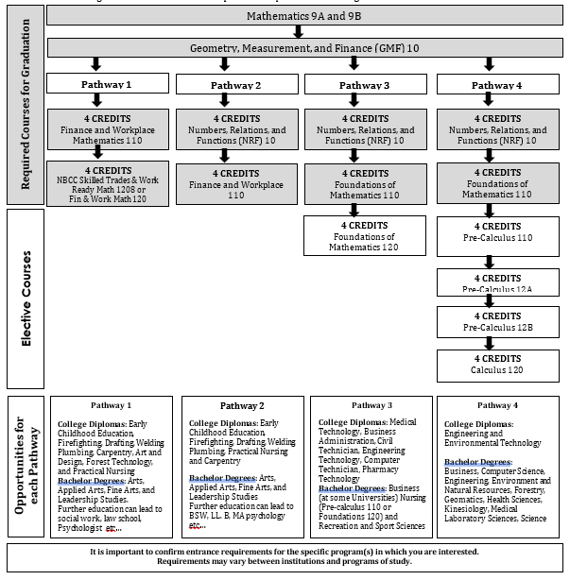
Math Pathways and Post Secondary Plans
Math Pathways

Slide 8
Special Programs
Co-Op 120 (8 or 12 credit hour options)
Long Term Care Coop 120
Early Childhood Coop 120
Fine Arts Certificate
French Immersion Program
Certificate of Immersion - 5 FI courses in 11 & 12: Be Careful in selecting!
Certificate of Proficiency – must be in a grade 12 FI course to be tested
Technical/Vocational Courses at FHS
Semester 1 – Framing and Sheathing 110 and
Residential Finish and Insulation
Semester 2 – Internal Combustion Engines 110 and
Tune Up and Emissions 120
Applications available at Guidance and due April 6th

Slide 9
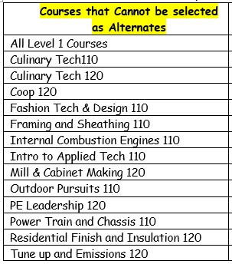
These courses cannot be selected as alternates because they are popular and will fill.

Slide 10
REMINDER
Graduation Requirements are not the same as Post-Secondary Admission Requirements-
Students must do some research

Slide 11
Choosing Courses
Choose courses carefully.
Courses chosen by students determine courses offered next year.
If you choose a course, you will be expected to remain in the course.
Once schedules have been created, course changes are not entertained.
Course planning sheets are due to their homeroom teacher on March 31st
April 3rd to 6th students need to be in homeroom to submit their course requests in the computer.

